Slide 1



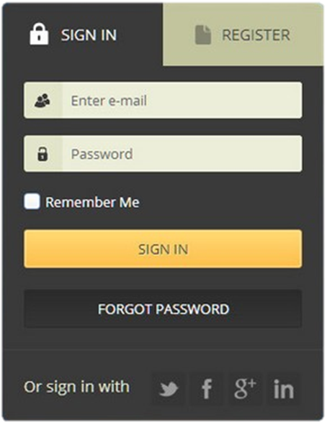

HTML Forms
Forms, Controls, Fields, Inputs, Submission, Validation
Svetlin Nakov
Technical Trainer
www.nakov.com
Software University
http://softuni.bg

Slide 2
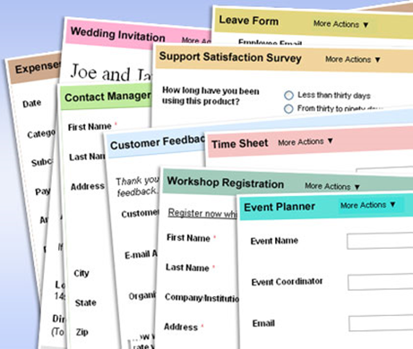
Table of Contents
HTML Forms
Form Fields and Fieldsets
Text Boxes
Buttons
Checkboxes and Radio Buttons
Select Fields
Hidden Fields
Sliders and Spinboxes
Validation Fields

Slide 3
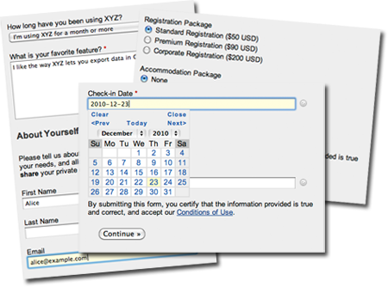
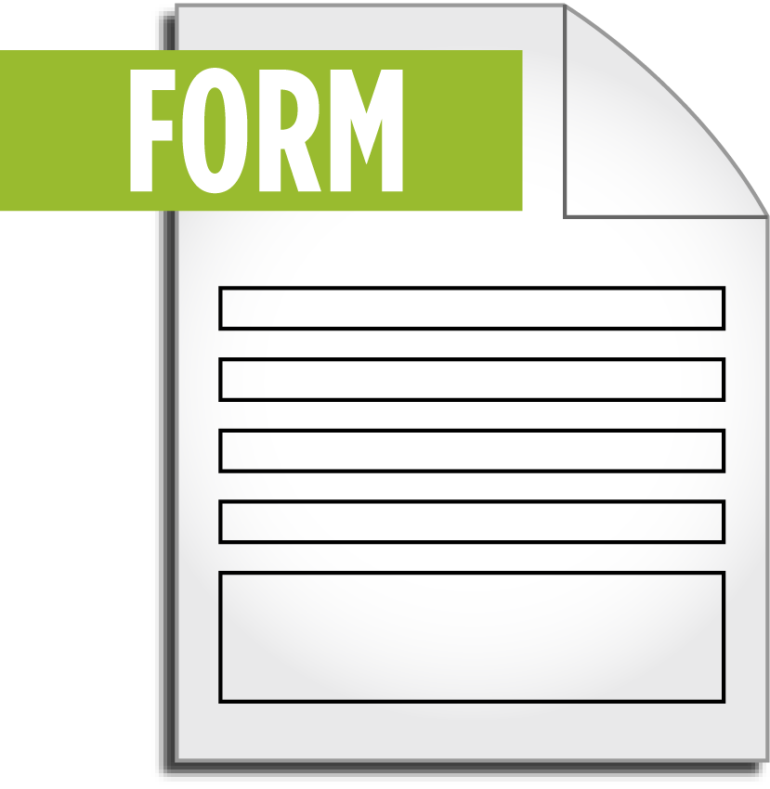
HTML Forms
Entering User Data from a Web Page

Slide 4
What are HTML Forms?
The primary method for gathering data from site visitors
HTML forms can hold
Text fields, drop-down lists, radio buttons, checkboxes, date / time fields, etc.
Buttons for interactions like [Register], [Login], [Search]
Sliders, range-selectors, date and time selectors, progress bars, etc…

Slide 5
How to Create a HTML Form?
Create a form block with the <form> tag
Example:
<form>
</form>
The "method" attribute tells how the form data should be sent – via HTTP GET or POST request
<form method="post" action="path/to/some-script.php">
<!-- form fields
come here -->
</form>
The "action" attribute tells where the form data should be sent

Slide 6

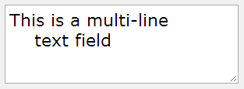

Text Fields
Single-line text input fields:
Multi-line text input fields (textarea):
Password input – a text field which masks the entered text with * signs
<input type="text" name="firstName" value="Nakov" />
<textarea name="comments">This is a multi-line text field</textarea>
<input type="password" name="pass" />

Slide 7





Buttons
Reset button – resets the form fields to their initial state
Submit button – sends the form data to the server:
Image button – submit button with image
Static button – no default action, used with JavaScript
<input type="reset" />
<input type="submit" value="Apply Now" />
<input type="image" src="go.gif" name="goBtn" alt="Submit" />
<input type="button" value="click me" />
<button>Click <b>Me</b></button>

Slide 8

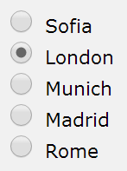
Checkboxes and Radio Buttons
Checkboxes:
Radio buttons in a group named "city":
Only radio button from the group can be selected
<p><input type="checkbox" name="agree" value="yes">I agree</p>
<input type="radio" name="city" value="1" /> Sofia <br />
<input type="radio" name="city" value="2" /> London <br />
<input type="radio" name="city" value="3" /> Munich <br />
<input type="radio" name="city" value="4" /> Madrid <br />
<input type="radio" name="city" value="5" /> Rome

Slide 9
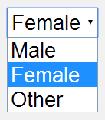
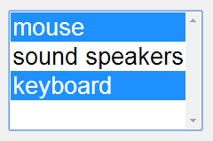
Select / Option Fields
Drop-down list:
Multiple-select list
<select name="gender">
<option value="Value 1">Male</option>
<option value="Value 2" selected="selected">Female</option>
<option value="Value 3">Other</option>
</select>
<select name="products" multiple="multiple">
<option value="202">mouse</option>
<option value="171">sound speakers</option>
<option value="146" selected="selected">keyboard</option>
</select>

Slide 10
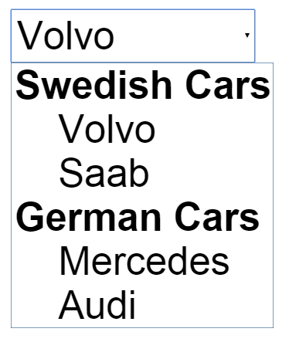
Select / Optgroup
Groups of Options
<select>
<optgroup label="Swedish Cars">
<option value="volvo">Volvo</option>
<option value="saab">Saab</option>
</optgroup>
<optgroup label="German Cars">
<option value="mercedes">Mercedes</option>
<option value="audi">Audi</option>
</optgroup>
</select>

Slide 11
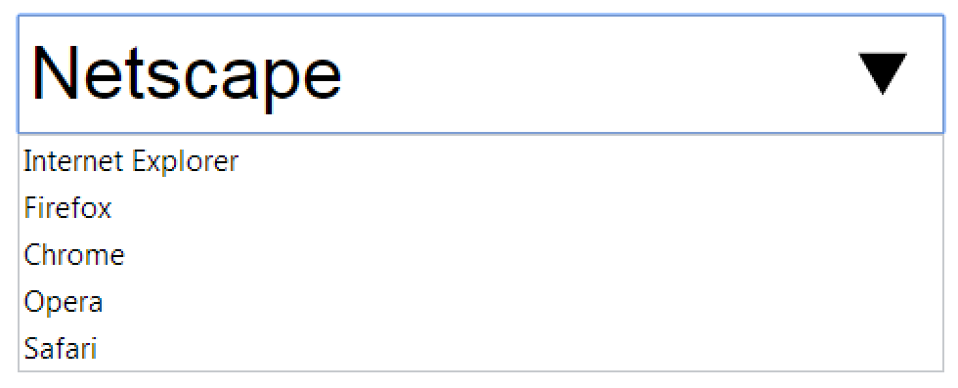
Data List
Data List
<input list="browsers" name="browser">
<datalist id="browsers">
<option value="Internet Explorer">
<option value="Firefox">
<option value="Chrome">
<option value="Opera">
<option value="Safari">
</datalist>
<input type="submit">

Slide 12

Labels
Labels are associate an explanatory text to a form field
Labels are linked to fields through the field's ID
Clicking on a label focuses its associated field
Inputs take the cursor / checkboxes are toggled / radio buttons are checked
Labels are:
Both a usability and accessibility feature
Required in to pass accessibility validation
<label for="fn">First Name</label>
<input type="text" id="fn" placeholder="enter name" />

Slide 13
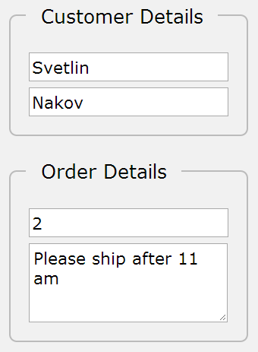
Fieldsets
<fieldset> are used to enclose a group of related form fields:
The <legend> is the fieldset's title
<form method="post" action="form.php">
<fieldset>
<legend>Customer Details</legend>
<input type="text" name="custName" />
<input type="text" name="custPhone" />
</fieldset>
<fieldset>
<legend>Order Details</legend>
<input type="text" name="quantity" />
<textarea name="remarks"></textarea>
</fieldset>
</form>

Slide 14




Range and Spinbox
Range / number inputs restricts users to enter only numbers
Additional attributes min, max, step and value
Can become spinbox or slider, depending on the input type
May be displayed differently on different browsers
May not work in some browsers (shown as normal text-boxes)
<input type="range" min="0" max="100" />
<input type="number" min="0" max="100" />

Slide 15
Hidden Fields
Hidden fields contain invisible form data
Not shown to the user, but submitted with the form
Used by JavaScript and server-side code
Not encrypted → can be easily intercepted
<input type="hidden" name="authkey" value="XfC4Ajgg6Zpa0hX7jLkw8" />
<input type="hidden" name="clientType" value="WebApp" />
<input type="hidden" name="language" value="English" />

Slide 16
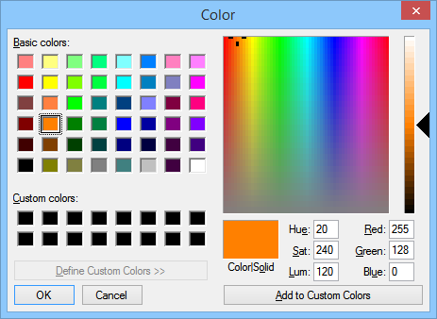

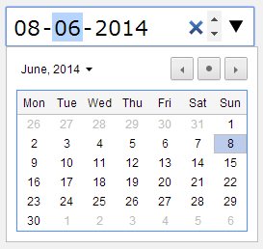


Other Input Types
Color picker
Date picker
Time picker
Date & time picker (combined)
<input name="backgroundColor" type="color" />
<input name="startDate" type="date" />
<input name="arrivalTime" type="time" />
<input name="departure" type="datetime" />

Slide 17
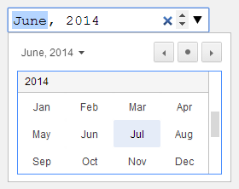
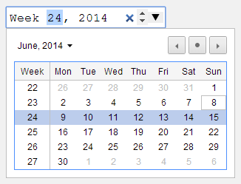


Other Input Types (2)
Month + year selection
Week of the year selection
File upload
Search box
<input name="logo" type="month" />
<input name="start" type="week" />
<input name="start" type="file" />
<input name="searchQuery" type="search" />

Slide 18






HTML Forms Inputs Fields
Live Demo

Slide 19

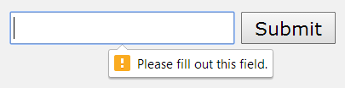
Field Attributes for All Field Types
Autocomplete
Browser keeps the previously typed values
Readonly – the field value cannot be changed
Autofocus
The field becomes on focus on page load
Required
The field is required to be filled / selected
<input type="text" name="fName" autocomplete="on" />
<input type="text" name="firstName" autofocus="autofocus" />
<input type="text" required="true" />

Slide 20
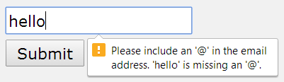
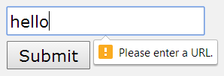

Input Fields with Validation
Email – provides a simple validation for email
In a mobile device brings the email keyboard
URL – has validation for URL address
In a mobile browser brings the url keyboard
Telephone – has validation for phone numbers
Brings the numeric keyboard in mobile browsers
<input type="email" required="true" />
<input type="url" required="true" />
<input type="tel" required="true" />

Slide 21
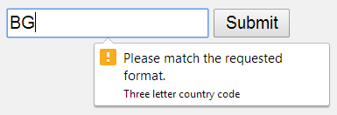
Regular Expressions Based Validation
HTML input fields can use regular expression validators
Check the input values client-side, before the form submission
Server-side checks should be also performed for security reasons
<input type="text" required="true" name="countryCode"
title="Three letter country code" pattern="[A-Za-z]{3}" />

Slide 22


HTML Forms Validation
Live Demo

Slide 23
Tab Index
The tabindex controls the order in which form fields and hyperlinks are focused when pressing the [TAB] key
Default: tabindex="0" (zero) – "natural" order
If X < Y, then elements with tabindex="X" are iterated before elements with tabindex="Y"
Elements with negative tabindex are skipped, however, this is not defined in the standard
<input type="text" name="second" tabindex="10" />
<input type="text" name="first" tabindex="5" />

Slide 24
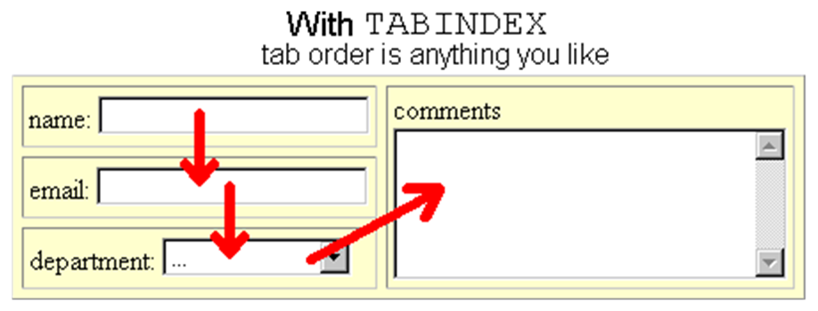


Tab Index
Live Demo

Slide 25
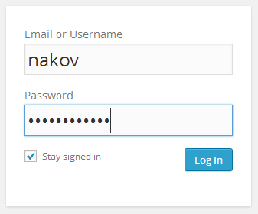
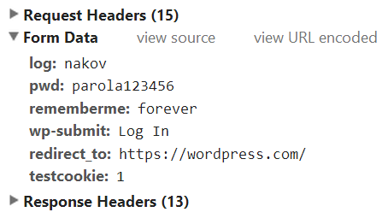
Form Submission
What Happens When We Submit a Form? GET vs. POST

Slide 26
Form Submission
When a form is submitted:
The browser sends the form data to the server
The "action" attribute tells where to send the form
The "method" attribute tells how to send the form (GET / POST)
GET sends the fields, encoded in the target URL:
All form fields are sent in format fieldname=fieldvalue
URL encoding is used to escape the special characters
http://www.mysite.com/?search=html&lang=en&location=US

Slide 27
Form Submission (2)
POST sends the fields in the HTTP request body:
POST http://wordpress.com/wp-login.php HTTP/1.1
Host: wordpress.com
…
Content-Type: application/x-www-form-urlencoded
login=nakov&pwd=parola123456&rememberme=forever&wp-submit=Log+In&redirect_to=https%3A%2F%2Fwordpress.com%2F&testcookie=1

Slide 28
Form Encryption Type (enctype)
The form encryption type (enctype)
Specifies how the browser encodes the form data
application/x-www-form-urlencoded
mutlipart/form-data
Content-Type:
application/x-www-form-urlencoded
login=nakov&pwd=parola123456&rememberme=forever&wp-submit=Log+In&redirect_to=https%3A%2F%2Fwordpress.com%2F&testcookie=1
Content-Type: mutlipart/form-data
------WebKitFormBoundary8vsGdK01cCe1m0mC
Content-Disposition: form-data; name="fileupload"; filename="logo.png"
Content-Type: image/png
…
------WebKitFormBoundary8vsGdK01cCe1m0mC
Content-Disposition: form-data; name="description"
SoftUni Logo

Slide 29

Summary
HTML Forms
Created by the <form> tag + method (GET / POST) + action)
GET → data sent in the URL; POST → data send in the body
Forms can hold many controls
Text boxes, text area, buttons, lists, drop-downs, check-boxes, radio-buttons, labels, field sets
Date / time / color selectors / spin boxes
Forms support regex validation

Slide 30
HTML Forms
https://softuni.bg/courses/web-fundamentals/

Slide 31
License
This course (slides, examples, demos, videos, homework, etc.) is licensed under the "Creative Commons Attribution-NonCommercial-ShareAlike 4.0 International" license
Attribution: this work may contain portions from
"HTML Basics" course by Telerik Academy under CC-BY-NC-SA license
"CSS Styling" course by Telerik Academy under CC-BY-NC-SA license

Slide 32







SoftUni Diamond Partners

Slide 33




Free Trainings @ Software University
Software University Foundation – softuni.org
Software University – High-Quality Education, Profession and Job for Software Developers
softuni.bg
Software University @ Facebook
facebook.com/SoftwareUniversity
Software University @ YouTube
youtube.com/SoftwareUniversity
Software University Forums – forum.softuni.bg

